Slide 1
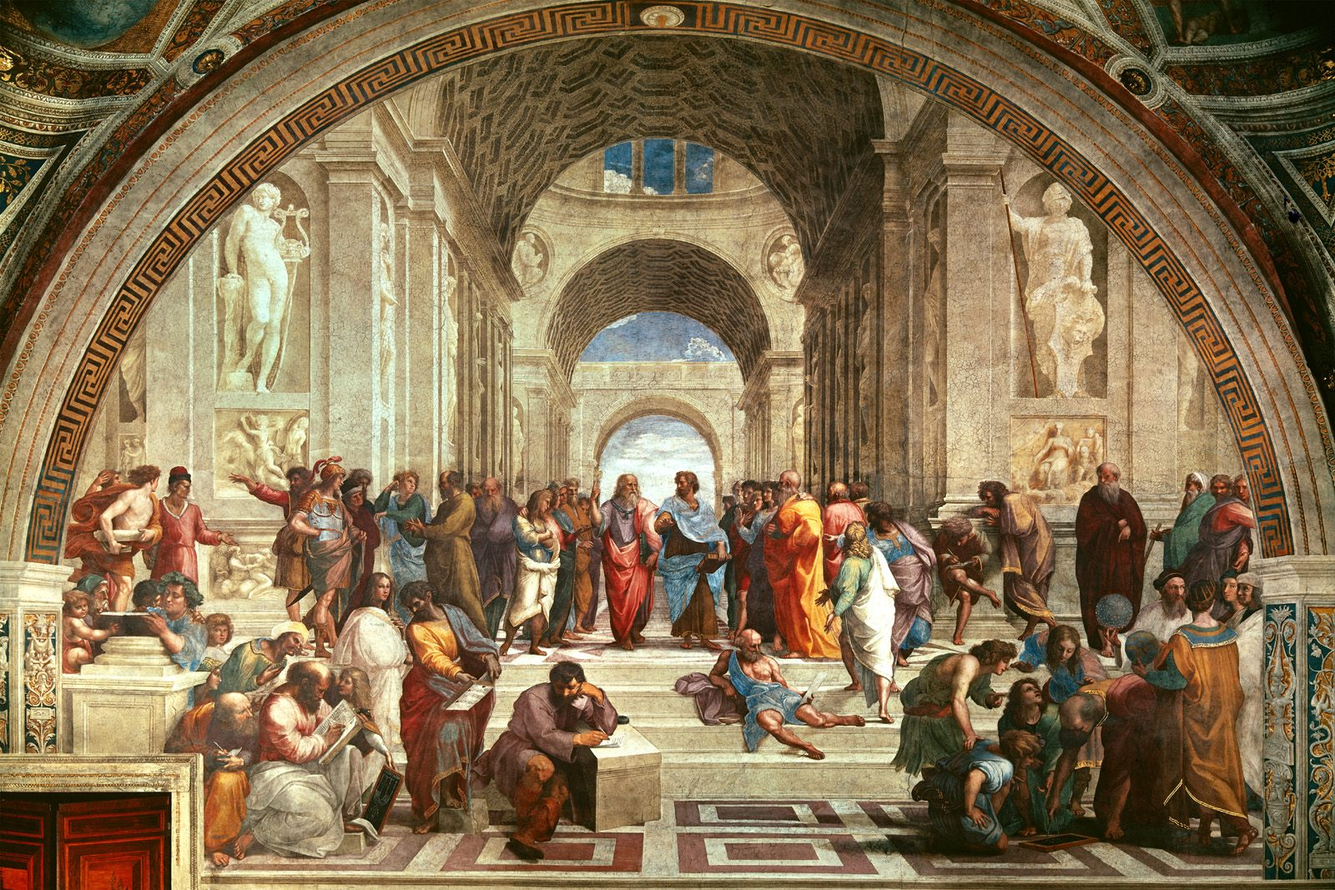
Meetkunde en Tegnologie Sessie 8
Onthou om jou mikrofoon af te sit
SBIDZ Open Saldanha Tegnologie in die onderrig van Wiskunde Aanlynkursus

Slide 2
Looking back
Tools determine reasoning
GSP skills
Affordances and constraints of the tool for meaningful learning
Advantages of using a dynamic tool
Geometric habits of mind for the 21st century
Session 2: You cannot believe your eyes. Reason!
Session 3: Constructions of a square: transformation tools, drag test Group reflection on DBE Use of Technology in schools
Session 4: Triangle sum constructions
Session 5: Equivalence, congruence
Session 6: From triangles to polygons
Session 7: The meanings of the Theorem for Pythagoras
Session 8: Geometric reasoning: Area
Constructing and drawing figures
Constructing lines perpendicular to and parallel to another line
Labelling and marking sides, vertices and angles
Measuring side lengths and angles
Transform figures: rotation, reflection, translation

Slide 3
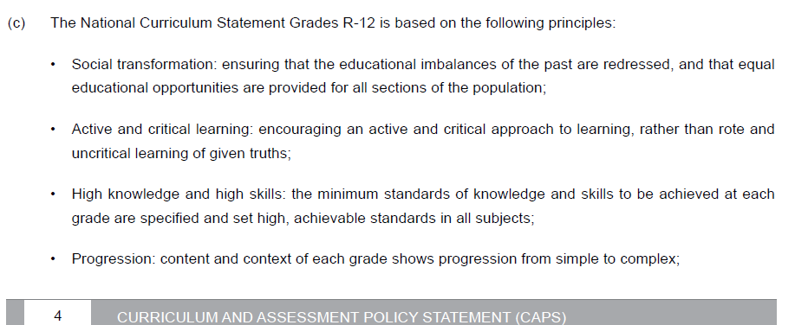
Where are we in relation to the curriculum?

Slide 4
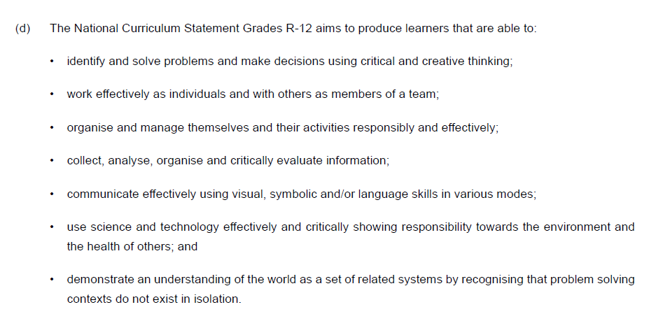
Where are we in relation to the curriculum?

Slide 8
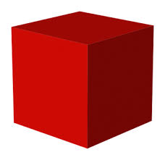
The focus in Senior Phase is “write clear definitions (Grade 8), once “compare”isons were made between properties of figures (Grade 7). The progression to Grade 9 is not in terms of content, but in terms of proof-reasoning.
The teacher’s task is to make connections between the content bullets, not to teach the content as a list: How are triangles related to quadrilaterals? How can we use triangle properties to reason about quadrilateral properties?

Slide 9
Session 6: Reasoning with dynamic constructions: Relationships between areas of (polygons)
Session outline
16:00 – 16:30 What is the conceptual origin of area measurement; the development of area measurement in primary school;
16:30 – 17:00 From triangles (and other figures) to rectangles: cut and move; Area between parallel lines; scaling area (proportional reasoning)
17:00 – 17:30 From rectangles to squares; House keeping

Slide 10
Big ideas
Area measure is based on the process of tessellating a plane figure with squares.
Reasoning with transformations: all squares are similar, hence enlargements of each other, and we can hence choose squares of different sizes (scaled up or down) without any loss of generality
Breaking up quadrilaterals (polygons) into triangles
Transforming (by dissection and motion) triangles to rectangles and then to squares
Units of measurement are completely arbitrary, hence we need to agree on a unit for the purpose of communication; and abstract the idea of unit as “that chosen to represent 1”

Slide 11
Die kubus hou ons meetstelsel The cube holds our measurement system
Using an edge as unit, linear distance and length can be measured by iteration
Using a face as unit, area can be measured by iteration
Using the cube itself as a unit, volume can be measured by iteration

Slide 12
Area by enclosing in rectangles
Enclose irregular parts in rectangles and reason about proportions
Omsluit die onreëlmatige dele in reghoeke en bedink die proporsionele verhoudings

Slide 13
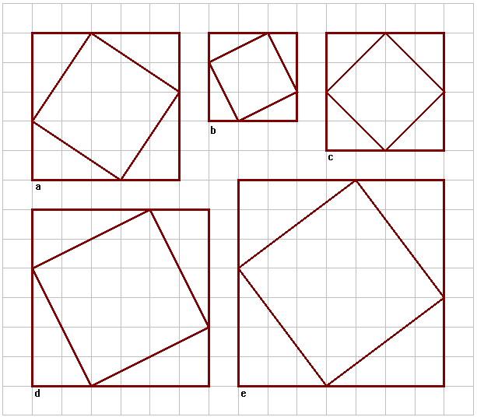
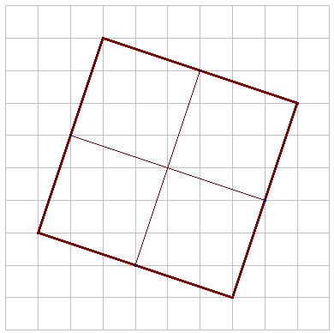
Area by enclosing in a square
What can you write about $\sqrt{40}$ by analysing the diagram?
In Euklidiese meetkunde is vierkantwortels konstrueerbare lengtes

Slide 14
Area as tessellation
Gee die grootte van parallelogram FGHI in terme van
Die blou driehoek (4 x 8) x 2
Die oranje ruit (4 x 8)
Die pers driehoek (4 x 8) x 2 /4
Many learners struggle to understand that the number of tessellating figures on the same area changes inversely proportional to the change in size of the tessellating unit
Baie leerders sukkel om te verstaan dat die aantal figure wat ‘n oppervlak tesselleer,omgekeerd eweredig is aan die grootte van die tessellerende figuur

Slide 15
Area and the midpoint cuts/Oppervlakte en halveerpunte
N, R en P is middelpunte van die lynstukke waarop hulle lê.
Wat is die verhouding tussen die oppervlaktes van die groen driehoek en die geel driehoek? Hoe weet jy?
Gee twee ander driehoeke met dieselfde verhouding tussen hulle oppervlaktes
Wat is die verhouding tussen die oppervlaktes van die verskillende driehoeke en vierhoeke waarin driehoek MQO verdeel is.
Gebruik GSP, Geogebra of Desmos om die verhoudings te toets nadat jy jou voorlopige stellings neergeskryf het.

Slide 16
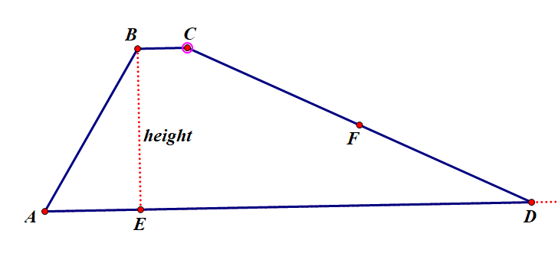
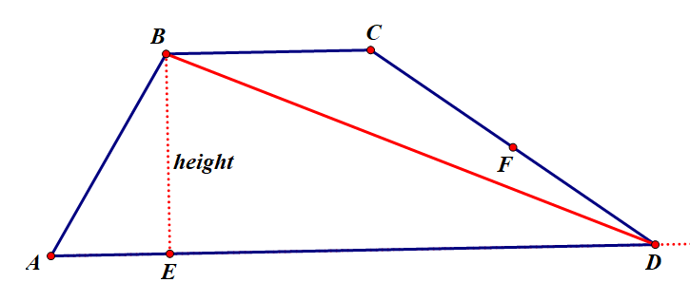
Area of a trapezium: formula
Making connections:
What is the relationship between the area of a triangle and the area of a trapezium?
With GSP you can drag point C towards B to consider the extreme case where the trapezium is a triangle. Reasoning with continuity: How does the area change as BC becomes shorter or longer?
From a dissection perspective, draw one diagonal to cut the trapezium into two triangles
From a transformation perspective, rotate the one parallel side to line up with the other parallel side and consider the triangles formed.

Slide 17
How to reconfigure a rectangle to a square without changing the area/ (Afr op volgende slide)
If the side lengths of the rectangle are $a$ and $b$, then the area of the square is $ab$ square units. So the side length of the square must be $\sqrt{ab}$ units.
Given lengths $a$ and $b$, calculate the value of $\sqrt{ab}$ . Use GSP to construct a segment with length $\sqrt{ab}$ . (the help menu explains the procedure). With the centre of the circle at A, and radius $\sqrt{ab}$ , find point x on side CD.
The next quest is to cut the rectangle in such a way as to produce useful right angles. Hence construct a line through B, perpendicular to AX.
Prove that BY is also $\sqrt{ab}$ .
Now it is a case of rotating, or sliding BY into the required positions to form the square.
Use congruence and properties derived from sliding and rotation, to prove that the triangle parts are congruent.
What is the area of the overlapping part?
Does your GSP construction pass the drag test?

Slide 18
How to reconfigure a rectangle to a square without changing the area/ Hoe om ‘n reghoek te vervorm na ‘n vierkant met dieselfde oppervlakte
As die sylengtges van die reghoek $s a$ en $b$is, dan is die oppervlakte van die reghoek $ab$ vierkante eenhede. Die sylengte van die vierkant moet dus $\sqrt{ab}$ eenhede wees.
Kies lengtes vir die reghoeksye $a$ en $b$, en bereken die lengte $\sqrt{ab}$ . Gebruik GSP om ‘n segment te konstrueer met lengte $\sqrt{ab}$ . (Die Help menu gee die prosedure). Met die middelpunt van die sirkel by A, en radius $\sqrt{ab}$ , vind die punt X op sy CD.
Die volgende mikpunt is om die reghoek so the sny dat daar bruikbare regtehoeke vorm. Konstrueer dus ‘n lyn deur B, loodreg op AX.
Bewys dat die lengte van BY = $\sqrt{ab}$ .
Noudat ons twee gelyke sylengtges het wat loodreg op mekaar is, is dit net ‘n kwessie van rotasie of skuif van die lynstuk BY om die vierkant te vorm. AX gee die skuifvektor.
Gebruik die eienskappe wat verkry is deur die rotasie of skuiftransformasie om te bewys dat die driehoekdele kongruent is.
Wat is die oppervlakte van die oorvleuelende gedeelte?

